Slide 1

We Will Begin Shortly

Slide 2

Introduction to Reinforcement Learning Workshop
Brought to you by:
Tyler Jackson, Haley Dozier, William Leonard, Jo Jabour

Slide 3
Please Ensure the Following:
You have an IDE ready to use that can interpret Python 3.7 or higher
You have Python 3.7 or higher downloaded on your machine
You have admin rights on your machine and can download packages onto it
You will be using the same machine for the second part of this workshop
The outlets at your table work (if needed for computer charging, etc.)
We will have more time during the workshop to ensure everyone is ready to start
WE WILL BEGIN SHORTLY

Slide 4
Meet the Instructors, Collaborators, and Speakers
Instructor: Tyler Jackson
Collaborators:
Joshua Church, Thomas Clement, et. al
Speakers:
Haley Dozier
William Leonard
Joseph Jabour

Slide 5
Objectives for RL Workshop
Become familiar with common Reinforcement Learning (RL) Algorithms and methods
Understand the fundamentals of RL and how to apply it for various scenarios
Comprehend the development of RL algorithms so that you can shape them to specific niche cases
Obtain hands-on experience with RL with a coding project and apply all methods taught in workshop to a common goal
Learn about real-world applications of the field and gain inspiration for future endeavors

Slide 6
Workshop Setup Details
Debugging Breaks and Breaks:
Debugging breaks are for either taking a mental break or collaborating to debug code with leaders
Breaks will be for rest.
No leaders will be available to help debug during these times.
Theory and Application:
We will walk through the process and theory behind all algorithms first.
Afterward we will be sure to apply all theory in a concise manner.
Equal time will be spent between these two parts.

Slide 7
Mission:
Learning heavy materials can be overwhelming.
With the help of a few of the workshop collaborators, we have decided to teach these complex methods using a simple problem: Tic-tac-toe
All algorithms will be applied toward a Tic-tac-toe game
All Tic-tac-toe mechanics and GUI will be pre-coded
We will be covering algorithms and RL models only
You will be able to play against the algorithm and models developed with a GUI

Slide 8
What We Will Learn:
Q-Learning Algorithms
Reward shaping
Q-Tables
Expert Data and Algorithms
Minimax Algorithm
Deep Q-Networks
Q-Learning Update Rule
DQN Equation
Deep Q-Learning from Demonstrations
Combining Expert Data and DQNs

Slide 9

Please Welcome Haley Dozier!

Slide 10

Thank You, Haley Dozier!

Slide 11
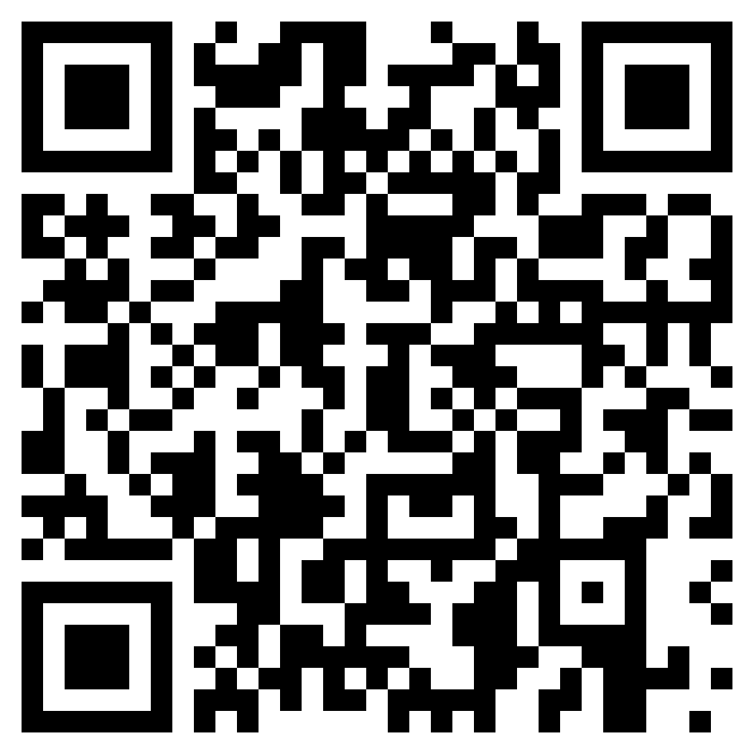
Coding Environment Setup
Ensure all requirements from earlier in our setup are met
Ensure you can access the GitHub repository
https://github.com/tylerjustinjackson/RL-Workshop-ITL/tree/main
Run ‘pip install numpy’
Run ‘pip install Torch’ to the Python version you will be using today
Test torch works with code below:
import torch
print(torch.__version__)
Alternatively, you can run the yml file from github to install all packages
Make sure you have the Tic-tac-toe GUI and mechanics downloaded from GitHub
We will take the next 30 minutes to ensure everyone is ready to proceed
Notes:
QR Code leads to GitHub link
Itinerary is on GitHub

Slide 12
The Forefathers of Reinforcement Learning
Richard Bellman 1950s- introduced the concept of dynamic programming and Markov Decision Processes (MDPs), which are foundational to modern RL.
Michael Lvovitch Tsetlin 1960s– created concept in computer science coined “learning automata.”
Richard Sutton and Andrew Barto (1992) – popularized Reinforcement Learning in the textbook "Reinforcement Learning: An Introduction”
Often credited as the two of the top contributors to the field of RL

Slide 13
What is Reinforcement Learning?
A branch of Machine Learning that allows you to train a model based on a reward system
The goal is to create some agent that will learn optimal decision-making strategies based on whether it gains or loses points.
Rewarding an agent negative points will discourage a given decision
Rewarding an agent positive points will encourage a given decision
The agent will experiment in many different states/scenarios
It will then make all possible moves to determine which decision is best and worse to make given a specific state
Notes:
More specifically a branch of Machine learning—maybe describe how it’s different from supervised and unsupervised learning

Slide 14
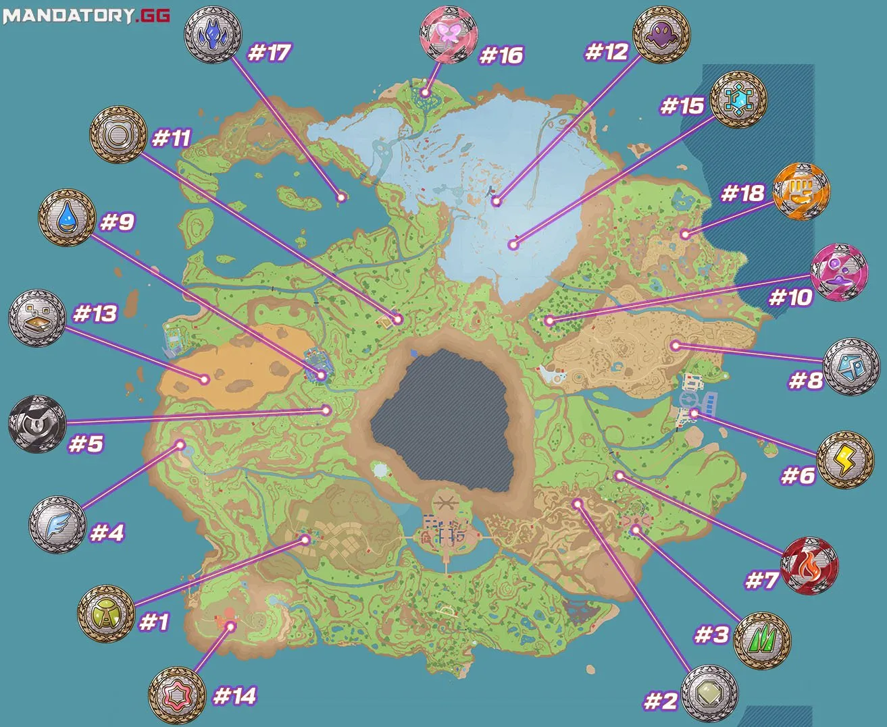
Reinforcement Learning Explanation with Pokémon Violet
Each point on the map is a gym
You need to go to each gym and defeat the leader to level up
By following the correct order, you will level up efficiently to beat the elite four
Following the incorrect order will allow you to level up but will be inefficient and may cause player to lose gym challenges
Imagine an agent being put into this map with no context and only knowing they need to beat the elite four.
Notes:
We can create an agent to navigate this world that will take in wins as positive feedback and losses as negative feedback
We can also shape the behavior by valuing HP after challenges and battles
By shaping the rewards, the agent can effectively master the environment in any way we would like

Slide 15
What is Reinforcement Learning? (cont.)
The agent will interact with an external environment and generate a model or data from its decision-making process that can be stored for later use
An agent will typically try to balance exploration with exploitation after it has garnered enough data to do so
Exploitation limits the consideration of new decision-making processes
Exploration can limit the optimization of a decision-making process within a given system
We will explore all aspects of this throughout the workshop and strike a balance between exploitation and exploration!

Slide 16
Key Distinctions in Reinforcement Learning
Unsupervised Learning:
Feedback: no explicit feedback
Objective: to find hidden patterns or groupings in the given data without predefined labels
Environment Interaction: analyzes static datasets without interaction with an environment
Supervised Learning:
Feedback: provides explicit and immediate feedback via labeled examples
Objective: to map input to outputs based on given examples
Environment Interaction: : analyzes static datasets without environment interaction
Notes:
Unsupervised Learning Examples:
Document Clustering:
Task: Grouping similar documents together based on content.
Example: Using clustering algorithms to organize a large collection of articles into topics.
Anomaly Detection:
Task: Identifying unusual patterns or outliers in data.
Example: Detecting fraudulent transactions in financial data by finding transactions that deviate from normal behavior.
Supervised Learning Examples:
Image Classification:
Task: Classifying images of handwritten digits into ten categories (0-9).
Example: MNIST dataset, where each image is labeled with the corresponding digit.
Spam Detection:
Task: Identifying whether an email is spam or not.
Example: Using a labeled dataset of emails marked as "spam" or "not spam" to train a classifier.

Slide 17
Key Distinctions in RL (cont.)
Reinforcement Learning:
Feedback: provides feedback in the form of rewards or penalties after each action
Objective: to learn a policy for decision making to maximize long term cumulative rewards
Environment Interaction: dynamic interaction with an environment where the agent’s actions influence future states and rewards

Slide 18

Applications of Reinforcement Learning
Autonomous Vehicles
Robotics, Healthcare
Energy Management
Manufacturing
Education
Example: Valtep.AI (Jackson, MS)
Notes:
Autonomous Vehicles – finds optimal path
Robotics, Healthcare – using robotic arms to learn the best methods for IVs and surgeries
Energy Management – optimizing the energy usage in a state – California pop. 55
Manufacturing – Optimizing material usage in factories
Education
Example: Valtep.AI (Jackson, MS) – using RL to personalize education in real time as a student uses the platform more and more with AR/VR – pilot trainings, and K-12

Slide 19

10 Minute Break
Notes:
During our next stint of time we will introduce how to use and apply RL and begin coding

Slide 20
Introduction to Q-Learning
Q-learning: a model-free reinforcement learning algorithm to learn the value of an action in a particular state.
Less commonly referred to as Quality-Learning
Key Concepts:
State: s, the current environment the agent encounters
Action: a, a given decision the agent can make in a particular state
Q-Value Function: Q(s,a), gives the expected reward value given a state and action
Objective: Optimize long-term cumulative rewards based on Q-Value function

Slide 21
Q-Learning Algorithm Goals:
Initialization:
Iterate over Q(s,a) arbitrarily for all state-action combinations (s,a)
Exploration and Exploitation:
Strike a balance between exploration (trying new actions) and exploitation (taking actions with the highest Q-value)

Slide 22
Q-Learning Update Rule
Goal:
To update Q(s,a) based on the observed reward r and the maximum expected future reward from the next state s′ and next action a′
Q-Learning Update Function:
Q(s,a) ← Q(s,a)+α [r+ γ′ max(a) ​Q(s′,a′) − Q(s,a)]
Such that:
α : is the learning rate and controls the impact of new information
r: is the immediate reward received after taking action a in state s
γ : is the discount factor and balances immediate and future rewards
maxa ​Q(s′,a′): is the maximum expected future reward from state s′ by taking the best action a′
The Q-Learning update equation returns a new function with updates weights as it iterates
Notes:
Gamma is γ
You want to maximize how much new information is taken in

Slide 23
Mathematical Derivation Overview
The Q-Learning update equation ensures convergence to the optimal policy under certain conditions
By iteratively updating Q(s,a), Q-Learning converges to Q∗(s,a), the optimal action-value function, which yields the optimal policy

Slide 24
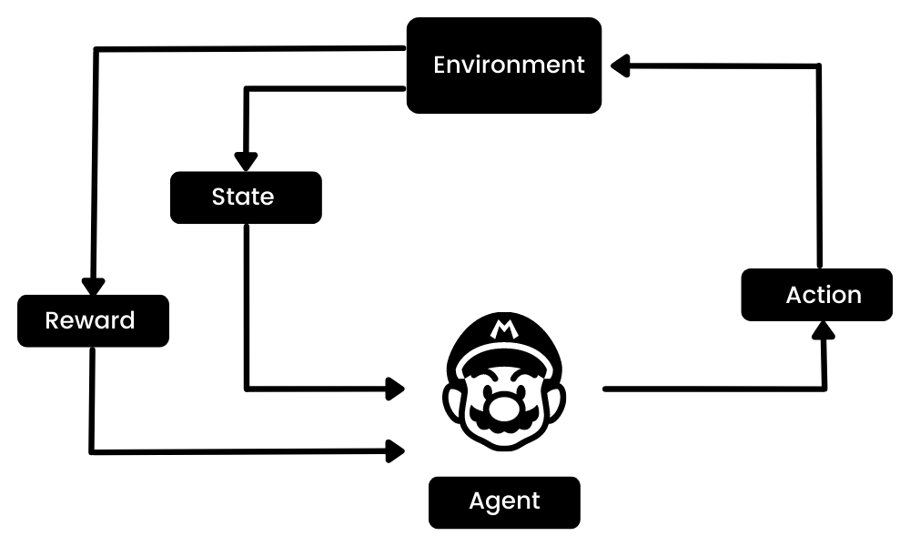
Q-Learning Algorithm Illustrations

Slide 25
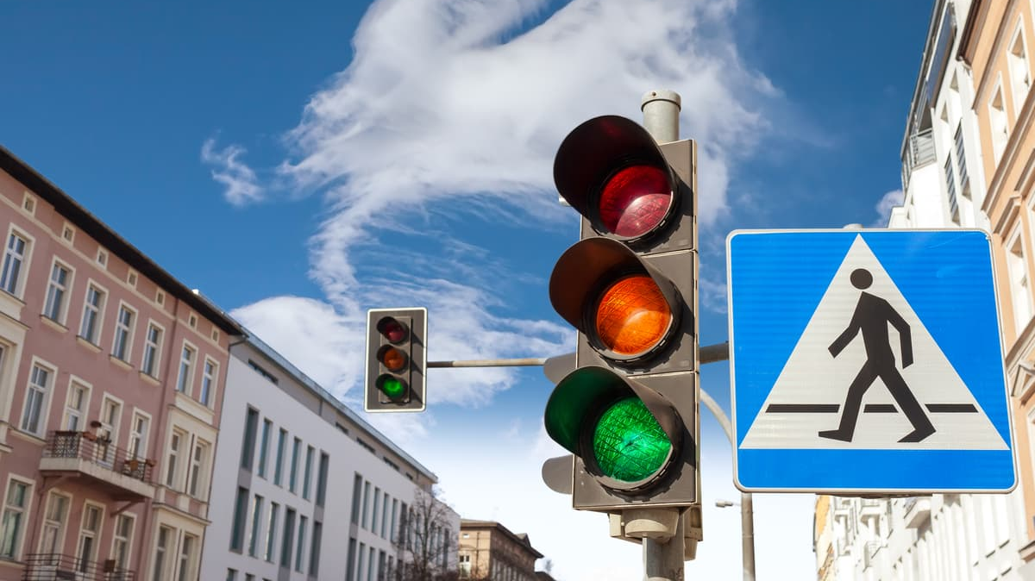
Applications of Q-Learning
Notes:
Intelligent stop lights use Reinforcement Learning to optimize traffic flow depending on time of day and number of car in a queue at the light.
Sensor integration is integral for this process as they use computer vision and sensors for environment navigation.

Slide 26

Coding The Q-Learning Algorithm

Slide 27

15 Minute Debugging Break
Notes:
During our next stint of time we will begin to learn about basic reward shaping and implement it into our program

Slide 28
History of Reward Shaping
1980s – first discussions of shaping rewards for RL algorithms
1990s – reward engineering emerged as a field of study
1995 – Andrew G. Barto and Steven J. Bradtke pioneer Reward Engineering’s viability
2009 – Matthew E. Taylor and Peter Stone’s “Transfer learning for reinforcement learning domains” paper pioneers a new age of RL for more complex tasks
Notes:
Transfer learning is a machine learning technique where a model trained for a specific task is used as the starting point for a different use case
This paper explores the application of transfer learning in reinforcement learning (RL) contexts. The core idea is that the experience and knowledge gained from learning one task (the source task) can improve the learning performance on a different but related task (the target task).
Reinforcement Learning here is used to guide the transferring process. There is a separate agent learning the best path to transfer knowledge from one domain to another

Slide 29
Introduction to Rewards and Reward Shaping
Rewards:
act as a signal to our RL agent to indicate the immediate benefit or consequence of following a given strategy
allow programmers to guide the agent toward the optimal behavior in a given system
Reward Shaping:
Augments the original reward signal to accelerate learning or guide the agent towards desirable behavior
Allows for convergence optimization and discourages undesirable action
Opens new possibilities such as gradual difficulty enhancement, expert demonstrations, and potential based shaping

Slide 30
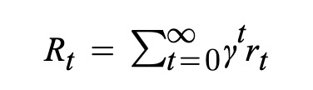
Mathematics and Impact of Reward Shaping
Reward Function R(s,a,s’):
Defines the reward received when transitioning from state s to state s’ by taking action a
Discounted Reward:
Equation to the right, where γ is the discount factor.
Impact:
Allows programmers to guide agent more closely ensure efficient optimizations
Considerations:
You can overfit and create misleading reward that can negatively effect optimizations

Slide 31
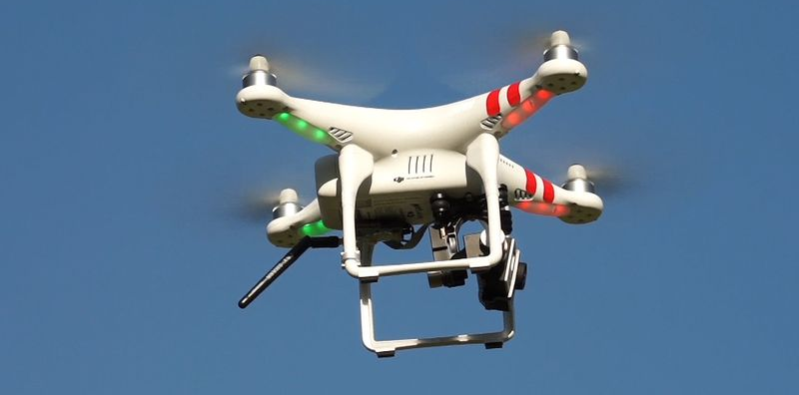
Interesting Applications of Reward Shaping
The paper “Meta-Reinforcement Learning for Reward Shaping” used Reinforcement Learning to find the best reward basis for a different Reinforcement Model
authored by Laura Graesser, Matthew J. Hausknecht, and Peter Stone
Reward Shaping can be used in complex systems including navigation for unmanned aerial vehicles
Notes:
Meta paper essentially used RL on a different RL model to get the best RL model

Slide 32

Coding Reward Shaping
Notes:
LET THE MASSES KNOW DO NOT TRAIN MODELS YET

Slide 33
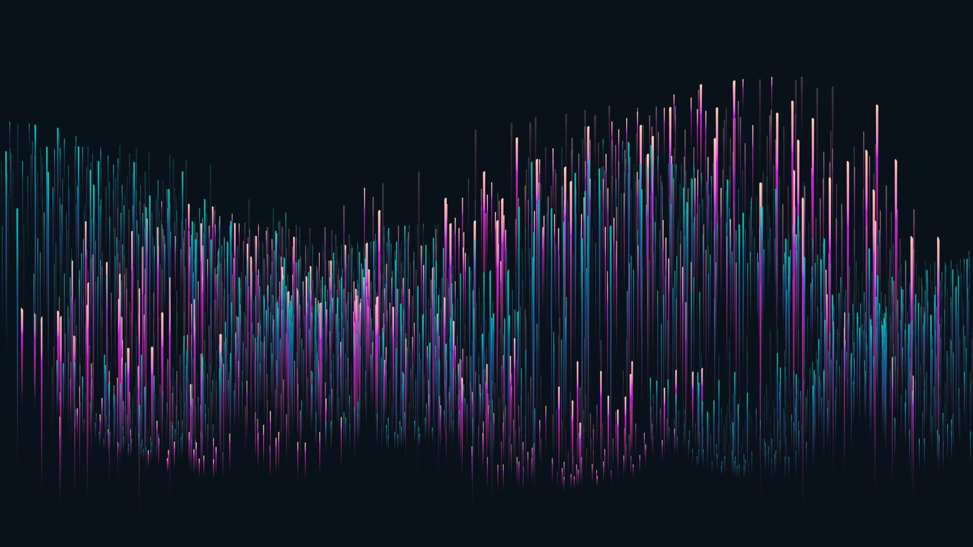
1 Hour Lunch Break
Notes:
During the next stint of time we will train our q-learning agents and play against them

Slide 34

Train your RL Model! Afterward Play Against RL Model in the GUI!

Slide 35

15 Minute Debugging Break

Slide 36
Drawbacks of Traditional Q-Learning
Does not immediately converge to a given optimal strategy or decision-making process
Could theoretically train indefinitely and still not be completely done
Scalability and Memory constraints may cause heavy concerns as we must create more state-action spaces depending on the size of our programs
This could render the updating Q-table function impractical
All in all, it may not always make the best decision for the entire game based on long term and short-term weights in the update function

Slide 37
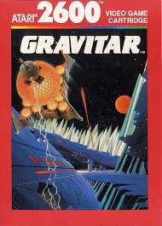
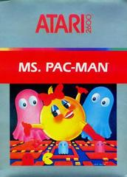
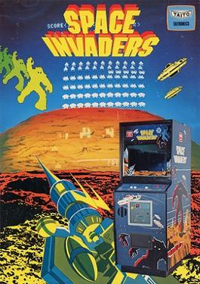
Drawbacks of Q-Learning in Real Life
The paper “Human-level control through deep reinforcement learning” speaks to the idea of traditional Q-Learning failing at handling complex environments.
Mnih, V. suggest Deep Q Learning as a solution to mitigate the simplistic nature of traditional Q-Learning
Mnih specifically studies Atari gameplay optimization using Reinforcement Learning
Ms. Pacman, Space Invaders, Gravitar, and more were all used in this study

Slide 38
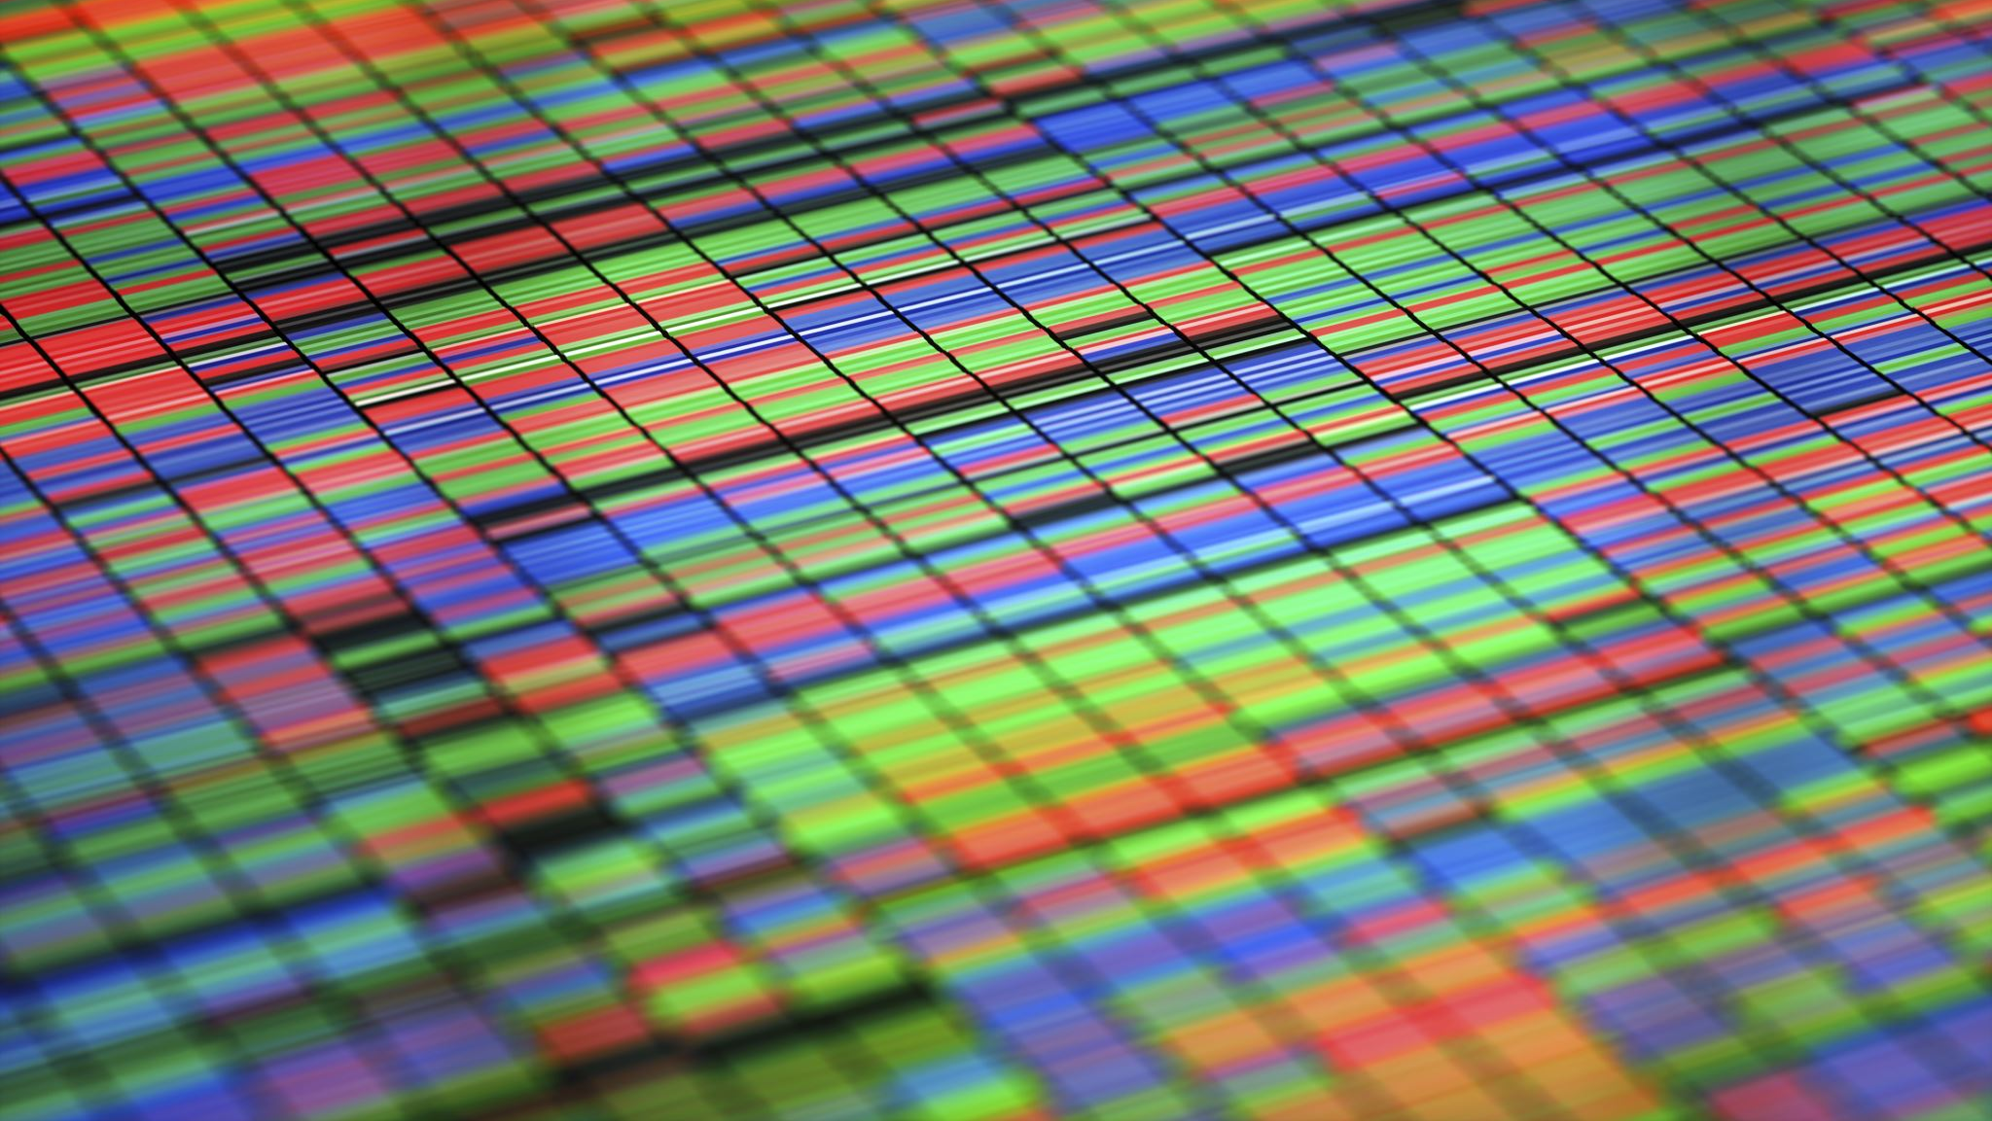
Using Expert Data and Algorithms as Alternatives

Slide 39
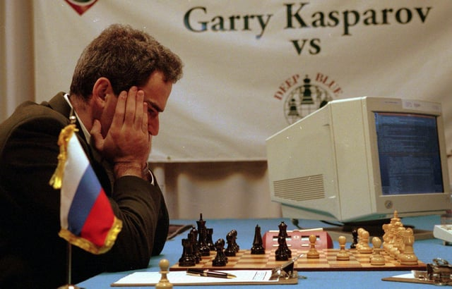
Introduction to Minimax
1928 – John von Neumann first mathematically proved minimax as a viable optimal algorithm for two player, zero-sum games to either minimize or maximize one’s strategy
1944 – John von Neumann and Oskar Morgenstern published “Theory of Games and Economic behavior
1977 – IBM’s Deep Thought algorithm, rooted in minimax, defeated the world chess champion Garry Kasparov
Notes:
A zero-sum game is a situation in game theory where one player's gain or loss is exactly balanced by the losses or gains of other players. In other words, the total sum of all players' payoffs is zero, meaning that one player's win is another player's loss.
1997, in conjunction with other algorithms, a minimax algorithm beat the world chess player with a score of 3.5 to 2.5
The event was a six-game match between IBM's Deep Blue and the reigning World Chess Champion, Garry Kasparov.
Minimax algorithm explanation on next slide

Slide 40
Minimax Algorithm Explanation
Minimax is a decision rule used in to maximize possible losses or wins in any scenario
Objective:
Minimize the possible loss for a worst-case scenario
Maximizing the minimum gain
Key concepts:
Maximizer: Player trying to maximize their score
Minimizer: player trying to minimize their score
Game tree: a tree structure representing all possible moves in a game

Slide 41
Minimax Algorithm Functionality
Generate the game tree to a specified depth
Assign scores to terminal nodes based on the game state
Propagate score back up the tree:
The maximizer will select the maximum value
Minimizer will select the minimum value

Slide 42
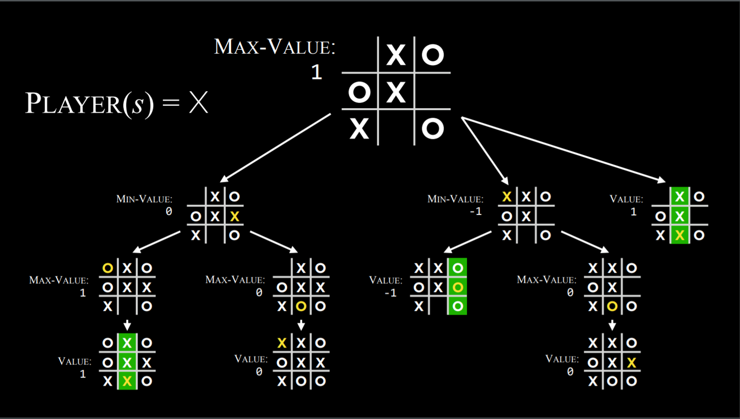
Notes:
Given the original state, the minimax algorithm creates a decision tree with all possible future states and outcomes. From this, it will follow the path with either the maximum number of average points or the minimum amount of points.
Think of minimax as a friend who overthinks the everything and plays out every scenario in their head to be extremely cautious on how to move.

Slide 43
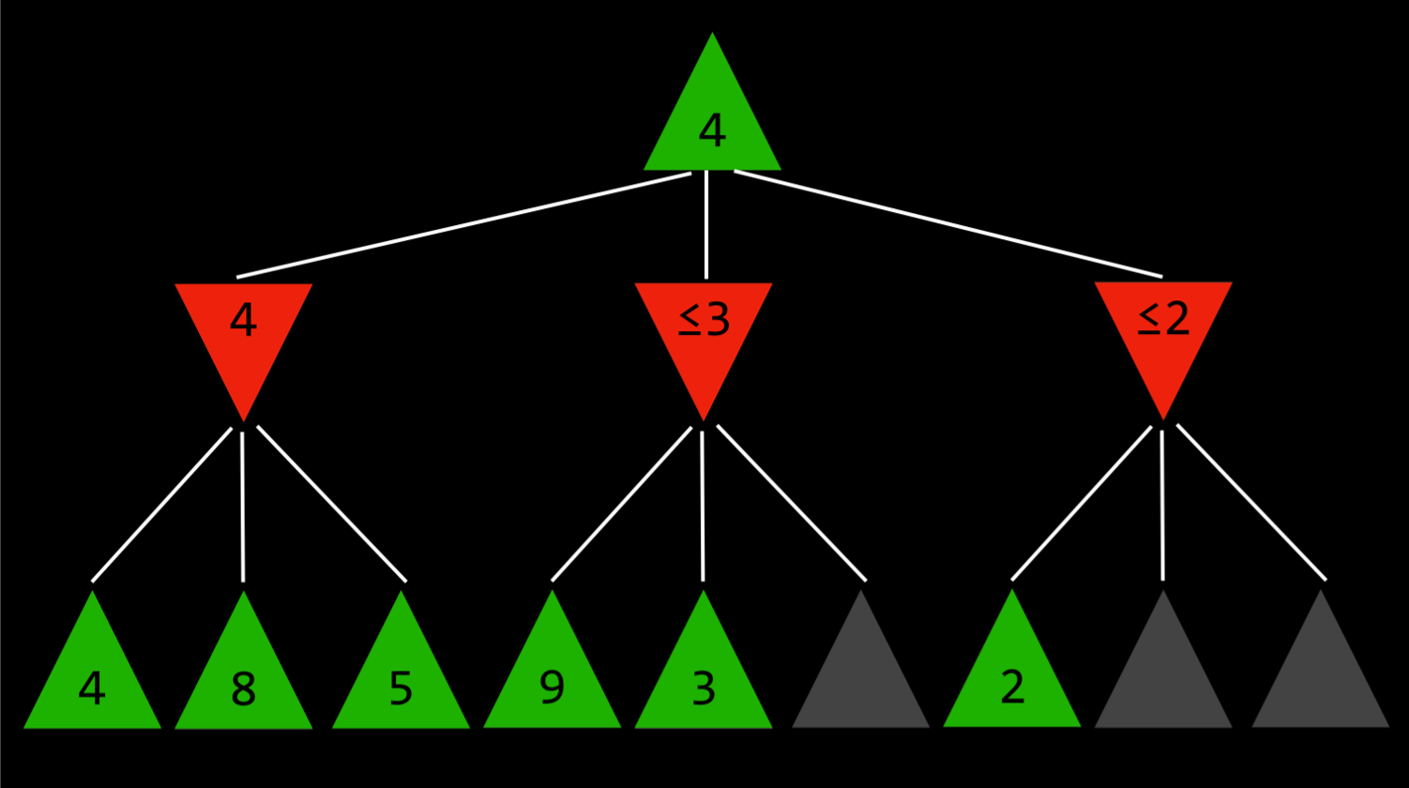
Notes:
Say you have an agent that knows how many points may be granted per decision. It now wants to maximize the minimum points it will receive from making a move. Once it finds the highest minimum out of the bunch, it will stop search and go with that decision.

Slide 44

Coding Minimax

Slide 45

Play against Minimax! Challenge: Try to Win

Slide 46

15 Minute Debugging Break

Slide 47
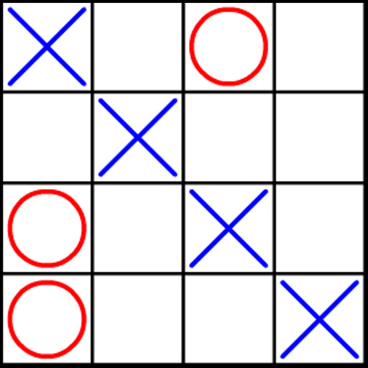
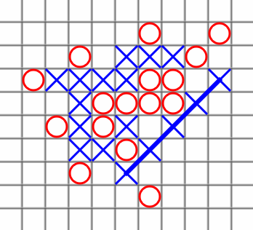
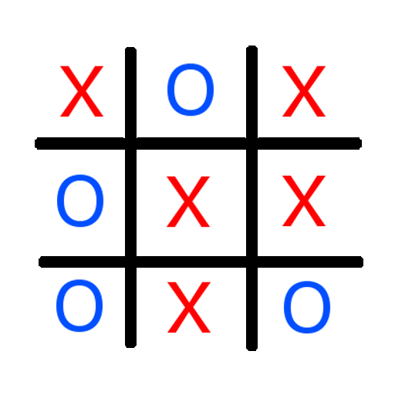
Drawbacks of Using Expert Data
Exclusively using expert algorithms and/or data can lead to scalability issues
Encountering new unaccounted for scenarios may exceed the capacity of a predefined algorithm
Notes:
Say you have a large space such as a 5x5, 20x20, or NxN tictactoe board. Accounting for every possible state that you could go into can be taxing computationally. Outside of minimax, if you have expert data, encountering new scenarios can be impossible without having a model make abstractions from what your data to generalize for later.
We will talk more about solutions after our guest speaker William Leonard!

Slide 48
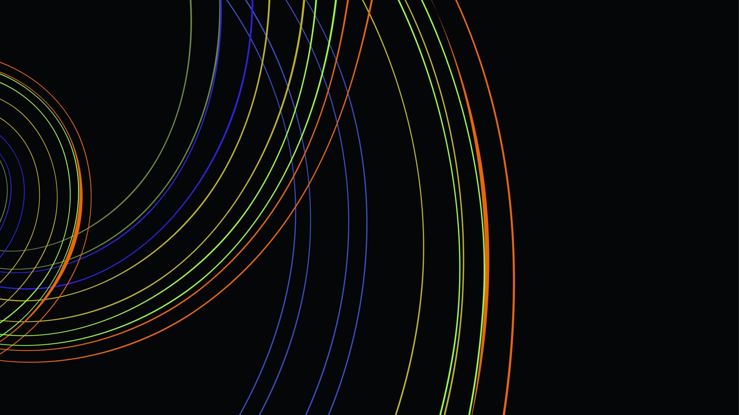
Please Welcome William Leonard!

Slide 49

Thank you, William Leonard!

Slide 50
Recap of Day 1, What We Learned
Q-Learning Fundamentals
Update Q-Learning Rule
Reward Shaping
Expert Data and Algorithms
Minimax Algorithm
Reinforcement Learning Applications
Notes:
feed back?

Slide 51
Looking Ahead, A Glimpse into Day 2
Advancing Reinforcement Learning
Introduction to Deep Learning
Introduction to Deep Q-Learning
Deep Q Networks (DQNs)
Combining DQNs with Expert Data
Deep Q-Learning from Demonstrations

Slide 52
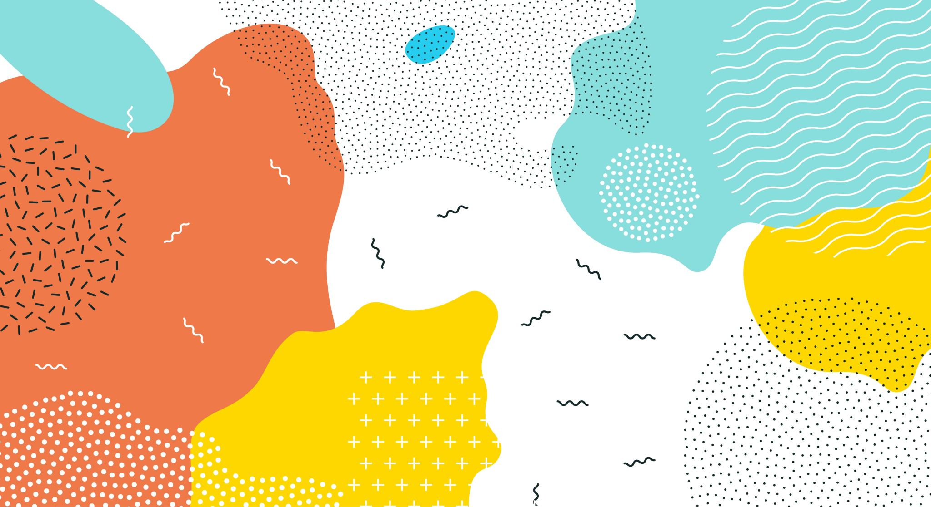
End of Day 1

Slide 53

Welcome to Day 2 We Will Begin Shortly

Slide 54
Please Load Day 1’s Work!
Ensure your entire environment is set up properly
Load Yesterday's GiitHub Repository
Download an IDE ready to use that can interpret Python 3.7 or higher
Ensure PyTorch (installed yesterday) is on your machine) with test code:
import torch
print(torch.__version__)
Ensure you have admin rights on your machine and can download packages onto it
Check the outlets at your table work (if needed for computer charging, etc.)
We Will Begin Shortly

Slide 55
Yesterday we….
Walked through the fundamentals of Q-Learning
Discussed the Q-Learning Update Rule
Discussed Reward Shaping
Learned how to apply Q-Learning with Q-Tables
Discussed state spaces and and space complexity
Discussed drawbacks of basic Q-Learning
Discussed simplistic nature and pitfalls
Discussed impracticality for complex environments

Slide 56
Yesterday We….
Explored Expert Algorithms and data such as Minimax
Displayed architecture and game tree design
Displayed decision making process of maximizing the minimum reward granted
Expressed the Drawbacks of Minimax
Expressed the space complexity as we go though larger, more sophisticated decision trees
Communicated the Drawbacks of Using expert data only
Scope of expert data may not be applicable to specific use case
RL can help make abstractions for further use on foreign environments rooted in expert data

Slide 57
Today We Will Discuss…
Advancing Reinforcement Learning
Overview of what models and algorithms are being applied currently
How we can transfer our knowledge of basic Q-learning to more sophisticated methods
Introduction to Deep Learning
What neural networks are and how to apply them
What uses Neural networks have for RL
Introduction to Deep Q-Learning
Bridge the gap between Deep learning and Reinforcement Learning

Slide 58
Today We Will Discuss…
Deep Q Networks (DQNs)
Architecture of Deep Q Networks and how to apply them
Architecture of how we connect DQNs to deep learning
Combining DQNs with Expert Data
Discussing the benefits or DQNs and minimax independently
Expressing how we would like these two to work together
Deep Q-Learning from Demonstrations (DQfDs)
Bridging the gap between DQNs and Expert data
Discussing the architecture to connect DQNs to minimax
Exploring how we can make abstractions using our model

Slide 59
Limitations from Q-Learning and Expert Data
Basic Q-Learning converges to an optimal algorithm based on experience
Without enough experience, models can often make suboptimal moves
Exploration vs. Exploitation can be a huge hindrance for making optimal decision making
Minimax can only make optimal moves based on predefined conditions
Using expert data form decisions in foreign environments can lead to suboptimal decision making

Slide 60
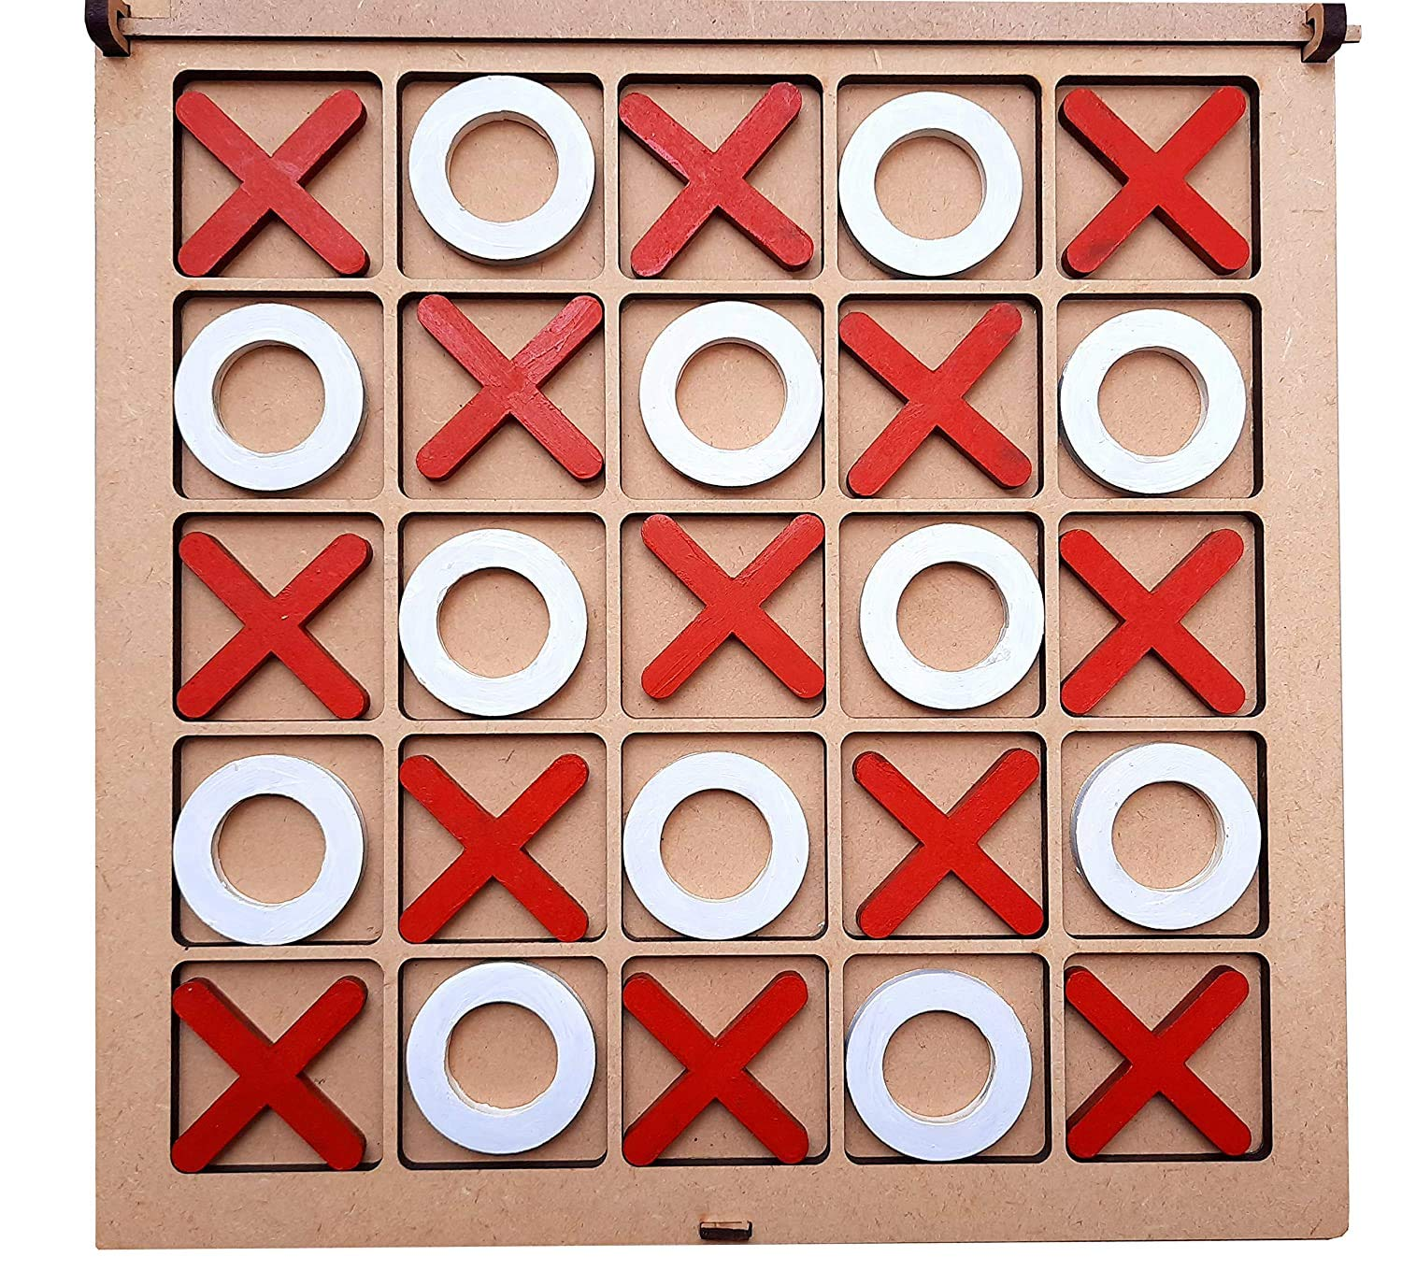
Examples of Basic Q-Learning Drawbacks
Adapting more complex environments outside of expert data or algorithm scope can be implausible
Using Basic Q-Learning may not be robust enough for
Environments with complex reward structures
Niche scenarios not trained on can cause discrepancies in policy making algorithms
Notes:
If you encounter a niche scenario that only comes up 1% of the time, you may never actually train on that scenario 1 time. The best way to get a good model for Basic Q-Learning is to train over all scenarios multiple times

Slide 61

Welcome Jo Jabour!

Slide 62

Thank You Jo Jabour!

Slide 63
Early Foundations of Deep Learning
1943 – McCulloch and Pits propose the first artificial neuron, building the foundation for neural networks
1957 – Frank Rosenblatt develops the first artificial neural network capable of learning
1986 – Geoffrey Hinton, David Rumelhart, and Ronald J Williams first popularize backpropagation for multilayer neural networks
2010s – computer vision, natural language processing, and speech recognition all use Deep Learning at their core today

Slide 64
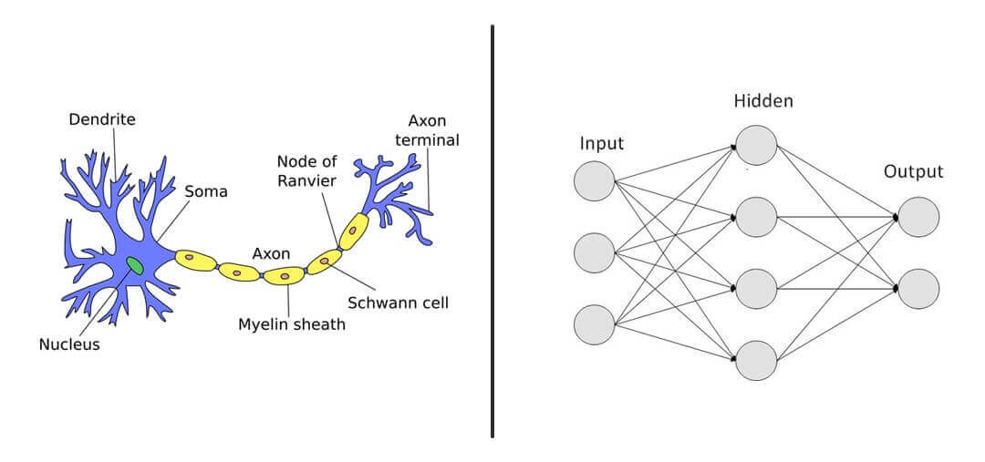
What are Neural Networks?
Neural networks are composed of layers of interconnected nodes (or neurons) that transform input data through learned weights
These are similar to physical neurons in your brain!
Notes:
They’re also universal function approximators

Slide 65
Similarities Between Biological and Artificial Neurons
Artificial Neural Networks (ANNs) draw immense inspiration from biological Neurons
Neurons contain a nucleus, receive signals from other neurons, and form junctions together
Similarly, ANNs mimic the information processing of biological neurons by using function weights and parameters to extract grouping within the environment
This allows the Network to make generalizations from the environment without being train on specific cases within explicit training on the scenario

Slide 66
Neural Networks as Universal Function Approximators
Neural networks are powerful computational models capable of approximating a wide range of complex functions.
This property, known as universal approximation, underpins their effectiveness in various domains, including machine learning and artificial intelligence.
Theoretical Foundation: A feedforward neural network with a single hidden layer containing a finite number of neurons can approximate any continuous function on compact subsets of the Real Numbers in a give space n, under mild conditions.
Notes:
TLDR, if there is a finite space and it can make create a finite number or neurons to approximate a continuous function.
Discontinuities in the environment can cause errors.
However, mitigations exist

Slide 67
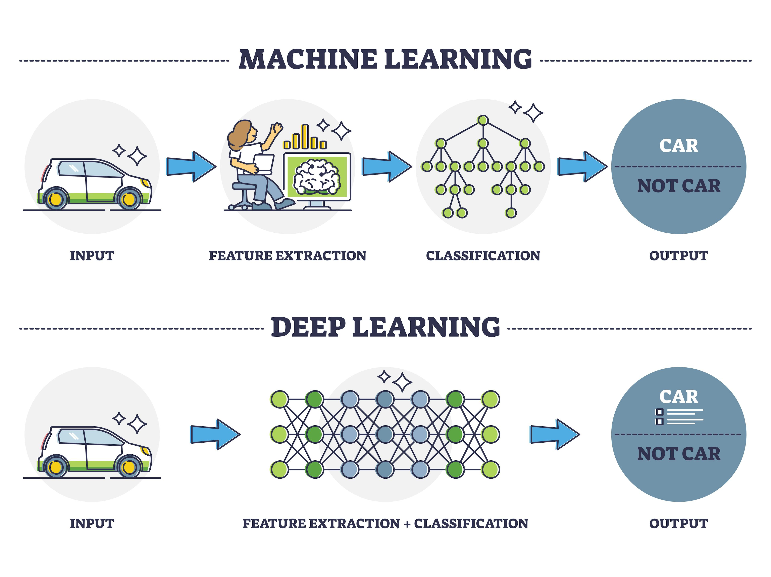
What is Deep Learning?
Deep Learning is a subset of machine learning that uses neural networks with many layers to model complex patterns in data
Deep learning aims to learn to represent data for various tasks like classification, regression, and generation

Slide 68
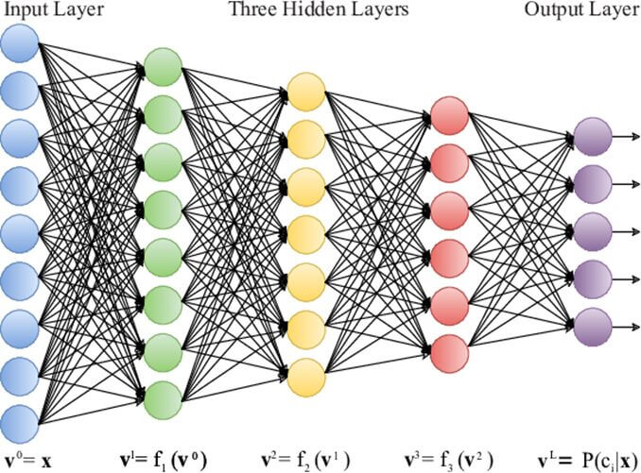
Architecture of Deep Learning
Input layer receives raw input features
Hidden layers perform transformations on inputs and capture intermediate representations
Output layer produces the final predictions

Slide 69
What are Deep Networks?
A neural network with multiple hidden layers, enabling the learning of hierarchical representations
This allows for the model to make abstract and complex representations of the input data as information flows deeper into the network

Slide 70
Hierarchical Feature Representation
Each layer in a deep network extracts features from the output of the previous layer
The more layers added into the network, the better the abstraction will be given the right rewards or parameters
Lower layers may detect simple patterns like edges in images
Higher layers combine the patterns from lower layers to recognize more complex structures such as an entire object

Slide 71
Non-linear Activation Functions
Deep networks rely on non-linear activation functions (ReLU, sigmoid, tanh) to introduce non-linearity into the network.
This allows them to approximate complex mappings between inputs and outputs
By leveraging multiple layers, deep networks excel in learning hierarchical abstractions from data without being trained on it explicitly

Slide 72
Forward Propagation Overview and Architecture
Overview: Neural Networks use forward propagation to process input data through the network’s layers to make predictions or produce outputs
Input layer:
The process starts with input data which can be any type of structured data such as an image, text, etc.
Weights and Biases:
Each input is associated with a weight. These weights determine the importance of each input in the network’s decision-making process
Each neuron in a layer typically has a bias term which allows the network to adjust the output independently of the input

Slide 73
Forward Propagation (Hidden Layers)
In each hidden layer, the weighted sum of the inputs is computed.
This step aggregates the information from the previous layer
The result of the summation is then passed through an activation function which, as mentioned earlier, introduces non-linearity into the network
This process is what powers the complex pattern finding we see in Neural Networks

Slide 74
Output Layer (Forward Propagation)
The final output of the network is generated based on the activation of the output layer neurons
This output could be a class label, a numerical value, or a probability distribution/classicification

Slide 75
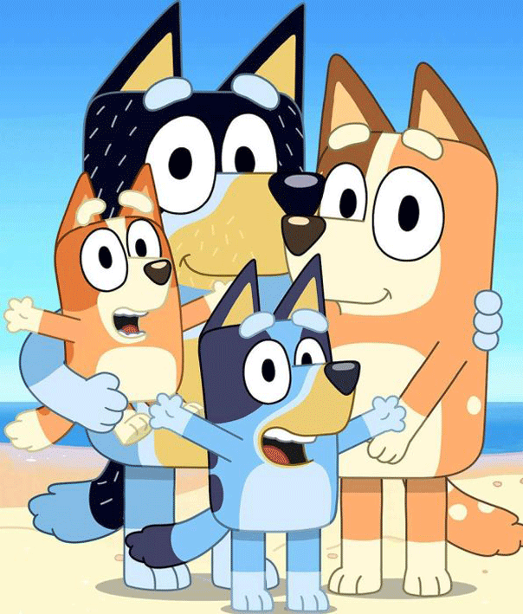
Example of Neural Network with Children’s Books and Media
Typically, when kids first see a show, they will take interest in it
After a while, they will begin to find patterns in the show and begin to recognize the show based on the first couple seconds of hearing the theme song
This would be the first few layers in a network making small generalizations
Not too long after, they could begin to recite entire episodes given enough “training” and repetition of watching the show and learning the cadences of it
This would be the deep layers of the network making more complex generalizations

Slide 76
Loss Function
In neural networks a loss function quantifies how well the network’s predictions match the actual target values during training
Its purpose to to evaluate the performance of the Neural Network and measure how far off the network’s predictions are from the actual target values
MSE (Mean Squared Error measures the average squared difference between prediction values and actual values in regression tasks such as this
MSE serves to help the loss function evaluate the Neural Network

Slide 77
Backpropagation Process
Backpropagation enables neural networks to learn from data by adjusting their weights and biases bases on the error calculated during the forward propagation process
This does the inverse of the forward propagation!
Its purpose is to optimize the parameters (weights and biases) so that the network can learn to make accurate predictions or classifications based on the input data
This is unlike forward propagation!
The purpose of forward propagation is to compute the predictions/outputs from the input data, and It passes through the network’s layers

Slide 78
Deep Learning Usages
Convolutional Neural Networks (CNNs) for grid-like data such as images
Example: AlexNet for ImageNet Classification
Natural Language Processing (NLP) for Recurrent Neural Networks (RNNs) for sequence data
Example: LSTM networks for language modeling and translation
Generative Models for Generative Adversarial Networks (GANs) which consist of a generator and a discriminator network
Example: generating realistic images from random noise

Slide 79
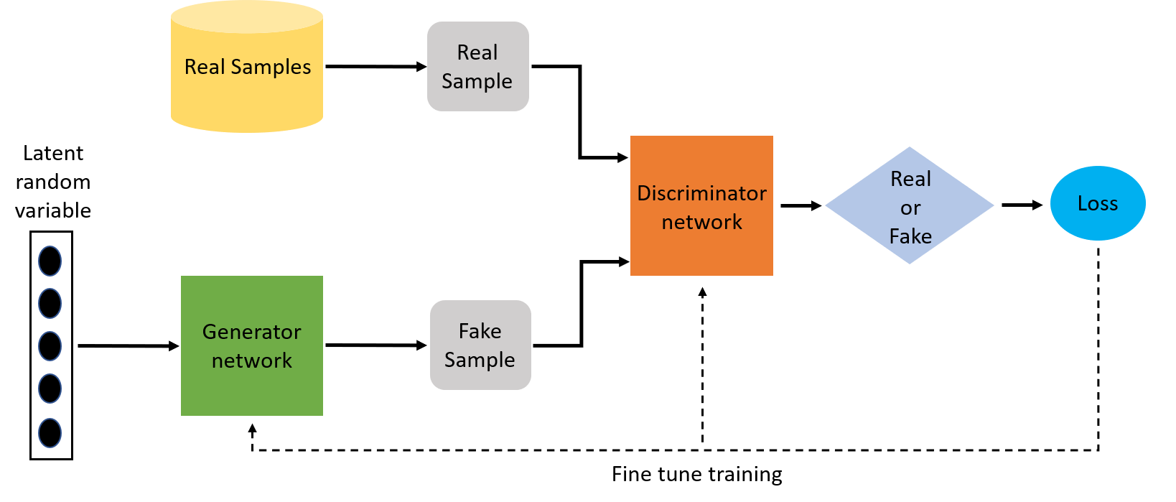
GANs Expanded
Notes:
Generator pushes out fake sample while we also push out real sample. The whole purpose of this is to discriminate and find the real one versus the fake.
Once this is found it will then be passed into the loss function.
Afterward, the loss will be passed into the GAN so it will know how close it is to looking real so that it may attempt to pass itself off as indistinquishable

Slide 80
Practicality of Deep Learning
Training Deep Networks:
Requires large amount of data for effective training
Utilizes GPUs for parallel processing
Tend to use regularization techniques like dropout to prevent overfitting
Transfer Learning:
Using pretrained models can allow us to focus on fine-tuning models for our use cases
Example: Fine-tuning BERT for sentiment analysis

Slide 81
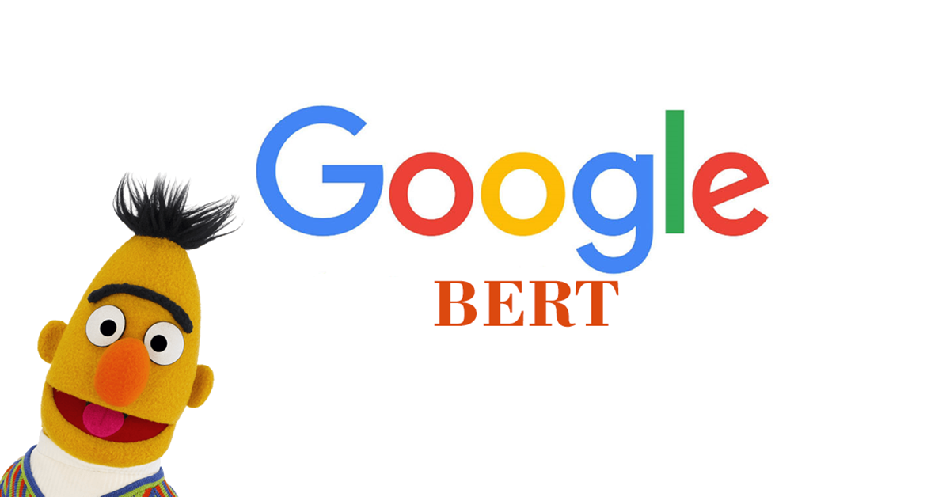
Notes:
BERT (Bidirectional Encoder Representations from Transformers) is a state-of-the-art natural language processing (NLP) model developed by Google. BERT is designed to understand the context of a word in search queries and other text by looking at the words that come before and after it. Many researchers has looked into fine-tuning BERT for sentiment analysis as it a very advanced NLP model that would be beneficial

Slide 82
What are Deep Q-Networks (DQNs)?
DQNs combine Q-Learning with deep neural networks to handle high-dimensional state spaces
Objective: uses deep learning to approximate the Q-Value function
This will enable reinforcement learning in complex environments

Slide 83
Key Concepts of DQNs
Q-Learning is a model free reinforcement learning algorithm for learning optimal policies
Deep Neural Networks utilize deep learning to approximate the Q-Value function

Slide 84
Brief History of Deep Q-Learning
Early 2010s – initial exploration and development of DQNs by DeepMind in the
“Nature Paper (2015)” is known as the breakthrough publication for DQNs which demonstrated its success in Atari 2600 games
DeepMind Sparked significant interest and further research in deep reinforcement learning

Slide 85
DQN Architecture Components
Neural Network Architecture
Typically consists of convolutional (CNNs) and fully connected layers
State Representation
Input layer receives state observations as input such as pixels from game frames
Action-Value Estimation
Output layer predicts Q-Values for each possible action

Slide 86
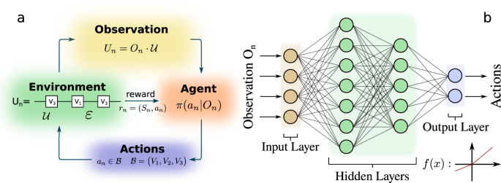
Deep Q-Learning Algorithm
Experience Replay stores experiences (state, action, reward, next state) in a replay buffer to break correlations and improve learning stability
Target Network is used to stabilize training by fixing Q-Value estimation during updates

Slide 87
Training Process for DQNs
Initialization: Initialize the neural network weights randomly.
Action Selection: Use an exploration-exploitation strategy (e.g., ε-greedy) to select actions.
Experience Replay: Sample mini-batches from the replay buffer to train the network.
Loss Calculation: Compute the loss using the Bellman equation and gradient descent.
Update Target Network: Periodically update the target network weights with the current Q-Network weights.

Slide 88
What is Batch Size and Minibatch?
Batch size refers to the number of training examples utilized in one forward and backward pass.
The choice of batch size is a crucial hyperparameter in the training of neural networks and can significantly impact the performance and convergence of the model
A mini-batch is a subset of the training data used to compute the gradient and update the model's parameters in one iteration.
Mini-batches allow for efficient training by leveraging the parallelism of modern hardware (such as GPUs) and improving the convergence rate of the learning algorithm

Slide 89
Importance of Batch Size and Mini-Batch…
Using mini-batches helps in efficiently utilizing computational resources.
By processing multiple examples simultaneously, the training can take advantage of hardware accelerations
Mini-batches provide a good trade-off between the noise and the stability of Batch Gradient Descent. They ensure that the updates are not too noisy, which can help in achieving faster convergence
The noise introduced by mini-batches can help in preventing overfitting, as the model does not get too accustomed to the training data.
This can improve the generalization capabilities of the model

Slide 90
Applications of DQNs
Atari Games and Other Game-Playing Capabilities
Example: DeepMind’s DQN playing Breakout, Space Invaders, and Pong
Robotics and Control Systems
Example: autonomous navigation in complex environments
Example: robotic arm task automation using visual input
Finance and Trading
Example: portfolio management system to optimize trading strategies

Slide 91
Drawbacks of DQNs
Tailoring Sample Efficiency: Learning effectively from limited experience
Generalization: Ensuring policies generalize well across difference environments
Exploration-Exploitation Trade-Off: Balancing exploration vs. exploitation

Slide 92
Summary of DQNs
What is a DQN?
A powerful approach in reinforcement learning that uses deep neural networks to handle complex decision-making tasks
What are applications of DQNs?
We can use DQNs in a wide range of applications such as game-play optimization, autonomous systems, and more

Slide 93
Overview of Double Deep Q-Learning
Double deep Q-Learning was proposed as a solution to overestimation bias in Q-Learning.
The concept involves decoupling the action selection from the action evaluation
2010 – Double Q-Learning was theorized in the paper "Double Q-learning" by Hado van Hasselt (2010)
2016 – The paper "Deep Reinforcement Learning with Double Q-learning" by Hado van Hasselt, Arthur Guez, and David Silver formally introduced Double Q-Learning Concepts

Slide 94
What are DDQNs? What is the Architecture?
DDQNs are an enhancement of DQNs designed to reduce the overestimation bias by separating the action selection from the action evaluation.
Architecture:
Primary Q-Network: Used to select the action that maximizes the Q-value.
Target Q-Network: Used to evaluate the Q-value of the selected action.

Slide 95
How do DDQNs work?
Action Selection:
Given a state s​, the primary network QQQ selects the action a​ that maximizes the Q-value.
Action Evaluation:
The target network Q′ is used to evaluate the Q-value of the selected action.

Slide 96
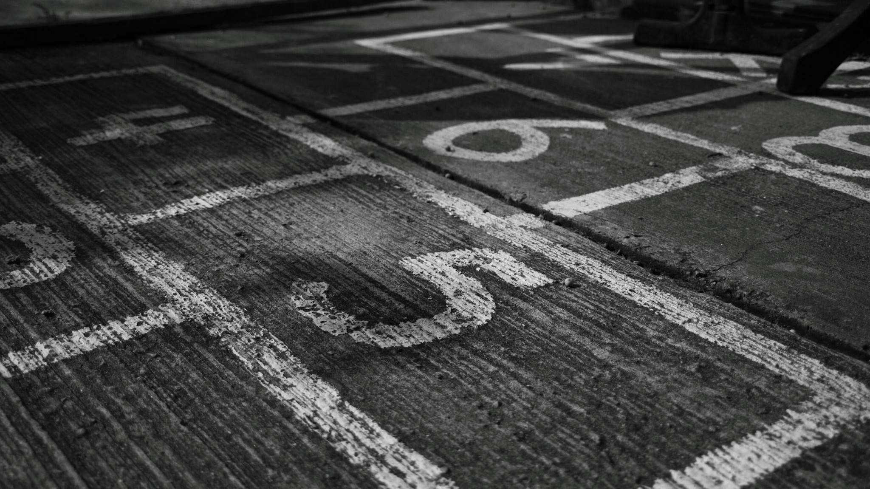
10 Minute Break

Slide 97

Coding DQNs

Slide 98
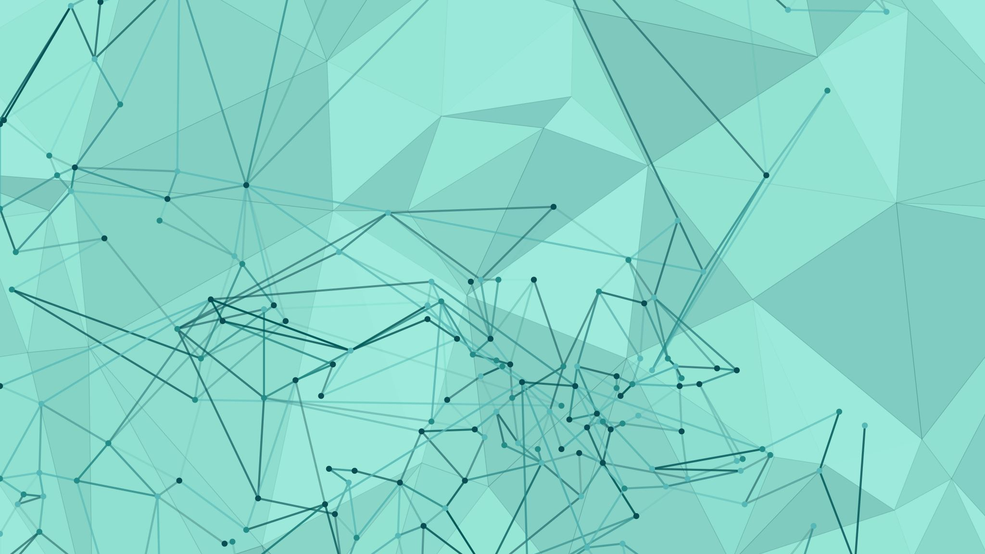
Training DQN Model

Slide 99

Play Against DQN

Slide 100

1-Hour Lunch Break

Slide 101
Drawbacks of DQNs: Instability and Divergence
Training a DQN can lead to instability and divergence of the Q-Values
This is mainly due to the correlation between the current Q-Values and the target Q-Values, which are updated simultaneously
Example: In a simple game, Q-Values may oscillate wildly during training, causing the agent to perform poorly or fail to learn a stable policy

Slide 102
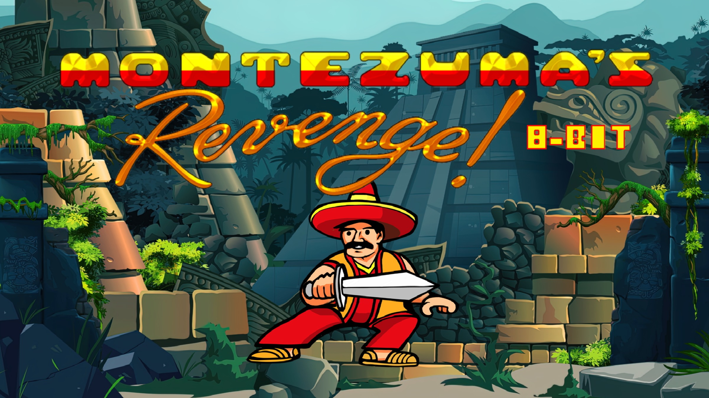
Instability and Divergence
Sparse and Infrequent Rewards
Long-Term Dependencies
Notes:
Sparse Rewards:
In "Montezuma's Revenge," rewards are infrequent, making it hard for the DQN to learn which actions lead to positive outcomes. The lack of frequent feedback can cause the Q-values to fluctuate wildly as the agent tries to find rewards.
Long-Term Dependencies:
The game requires the agent to perform a sequence of actions over a long period before receiving any reward (e.g., finding a key and using it to open a door). DQNs struggle with these long-term dependencies because they primarily focus on immediate rewards.
Exploration vs. Exploitation:
Effective exploration is crucial in this game due to the vast state space. However, DQNs might either explore too much, leading to slow convergence, or exploit too soon, missing out on discovering better strategies.
Unstable Updates:
DQNs update Q-values using the Bellman equation, but the use of a function approximator (a deep neural network) can lead to instability. This instability arises from the correlation between Q-value updates and the current policy, leading to oscillations or divergence in Q-values

Slide 103
Drawbacks of DQNs: Large State Spaces
DQNs struggle with environments that have very large or continuous state spaces
Performance typically relies on the quality and representativeness of the training data, which can be sparse in large state-spaces
Example: in the game of Go, traditional DQNs may fail due to large state space because they are not able to generalize form limited training incentives/data

Slide 104
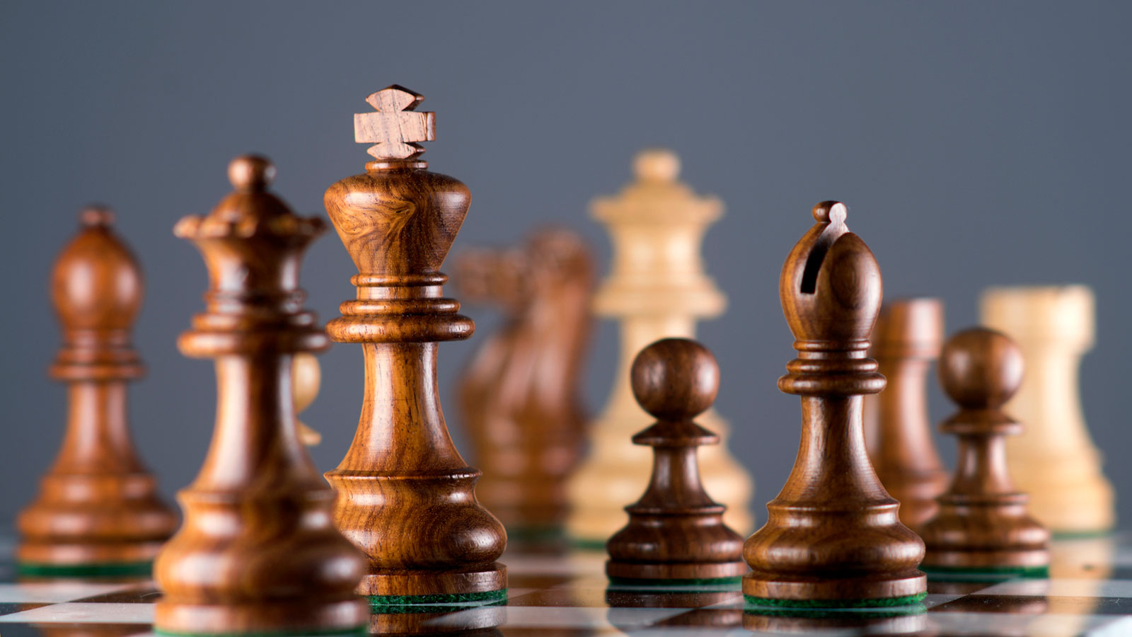
Large State Spaces
10^40 Possible Configurations
Sparse Reward
Notes:
Complex State Representation:
Each state in chess is represented by a unique configuration of 64 squares, each containing one of 12 types of pieces (6 types for each player). The sheer number of possible board configurations makes it impractical to store and explore each state individually.
Sparse Rewards:
Chess typically provides rewards only at the end of the game (win, lose, or draw). This sparsity makes it challenging for DQNs to learn which intermediate moves contribute to achieving a win or avoiding a loss.
Long-Term Planning:
Chess requires long-term planning and strategy, often involving sequences of moves that lead to advantageous positions or checkmate. DQNs, which typically focus on immediate rewards, may struggle to learn these complex sequences without proper guidance.
Memory and Generalization:
Storing and generalizing from experience in chess is difficult due to the vast state space. DQNs may fail to generalize well from encountered states to unseen states, leading to poor performance against novel opponents or positions

Slide 105
Drawbacks of DQNs: Overestimation Bias
DQNs can suffer from overestimation bias where the Q-Values tend to be higher than the actual expected returns which can lead to suboptimal policies
Example: overestimation in navigation tasks can cause the agent to prefer routes that seem more rewarding but are less efficient or more dangerous

Slide 106
Solutions to Drawbacks of DQNs
Be sure to:
Customize and fine-tune your model and weights
Test weights on small sample before allowing model to converge completely
Reassess the incentives given to DQN to optimize convergence

Slide 107
Transfer Learning
Transfer learning is a technique in machine learning where a model developed for a particular task is reused as the starting point for a model on a second task.
It leverages knowledge gained from one domain to improve learning in another domain, often leading to faster convergence and better performance,
This is helpful especially when the target domain has limited data.
Hold that thought!! We will see how this all ties in with our coming topic in a few slides

Slide 108
Deep Q-Learning from Demonstrations (DQfD)
Deep Q-Learning from Demonstrations is an extension of Deep Q-Networks (DQNs) that incorporates expert demonstrations into the learning process
Objective: to accelerate the learning process and/or the model’s performance by leveraging expert knowledge and demonstrations alongside traditional reinforcement learning

Slide 109
Key Concepts for DQfDs
Expert Demonstrations use pre-collected data from expert behavior to guide the learning process
Hybrid Learning combines supervised learning from demonstrations with reinforcement learning from interaction with the environment

Slide 110
History of DQfDs
Early 2010s – Initial concepts of learning from demonstrations explored in the context of reinforcement learning.
DeepMind’s DQfD (2016): DeepMind introduced DQfD, showcasing its potential to leverage expert demonstrations for improved learning efficiency.
DeepMind’s Paper Publication (2017): Detailed the methodology and demonstrated the effectiveness of DQfD in Atari games

Slide 111
DQfD Components
Neural Network Architecture: Like DQNs, typically consisting of convolutional and fully connected layers.
Replay Buffer: Maintains two buffers—one for demonstrations and one for self-generated experiences.

Slide 112
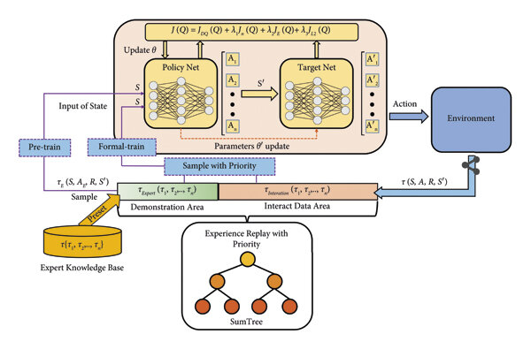
DQfD Algorithm
Initialization: Pre-train the neural network using the expert demonstration data.
Loss Function: Combines supervised learning loss from demonstrations with reinforcement learning loss

Slide 113
Transfer Learning and DQfDs…
Transfer learning in DQfD can enhance the efficiency and effectiveness of the learning process by leveraging pre-trained models and expert demonstrations.
We can utilize models trained on similar tasks or environments as the starting point.
This can provide a robust initial policy, reducing the learning time and improving stability.
In our case we will use minimax for our expert data
We can integrate expert demonstrations from the source task to guide the learning process in the target task.
These demonstrations can provide valuable insights into optimal policies, helping the agent learn more effectively.
Fine-tune the pre-trained algorithm/model on the new task using the target domain data.
This allows the model to adapt to the specific nuances of the new task while retaining useful knowledge from the source task.

Slide 114
Training Process for DQfDs
Pre-training: Use demonstration data to pre-train the network, providing a strong initial policy.
Experience Replay: Store both demonstration and self-generated experiences in replay buffers.
Action Selection: Use an exploration-exploitation strategy to select actions.
Loss Calculation: Compute the combined loss function.
Gradient Descent: Update the network weights using the combined loss.
Policy Improvement: Iteratively improve the policy through interaction with the environment and learning from both buffers.

Slide 115
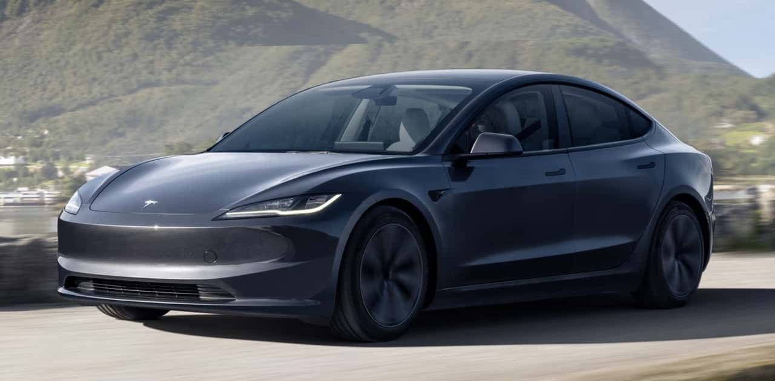
Applications of DQfDs
Usages include game-playing, autonomous vehicles, control systems, and more
Example: Tesla offers an opt-in program that records all driver data to train autonomous-driving models from customer usage

Slide 116

Code DQfD Algorithm

Slide 117

15 Minute Debugging Break

Slide 118
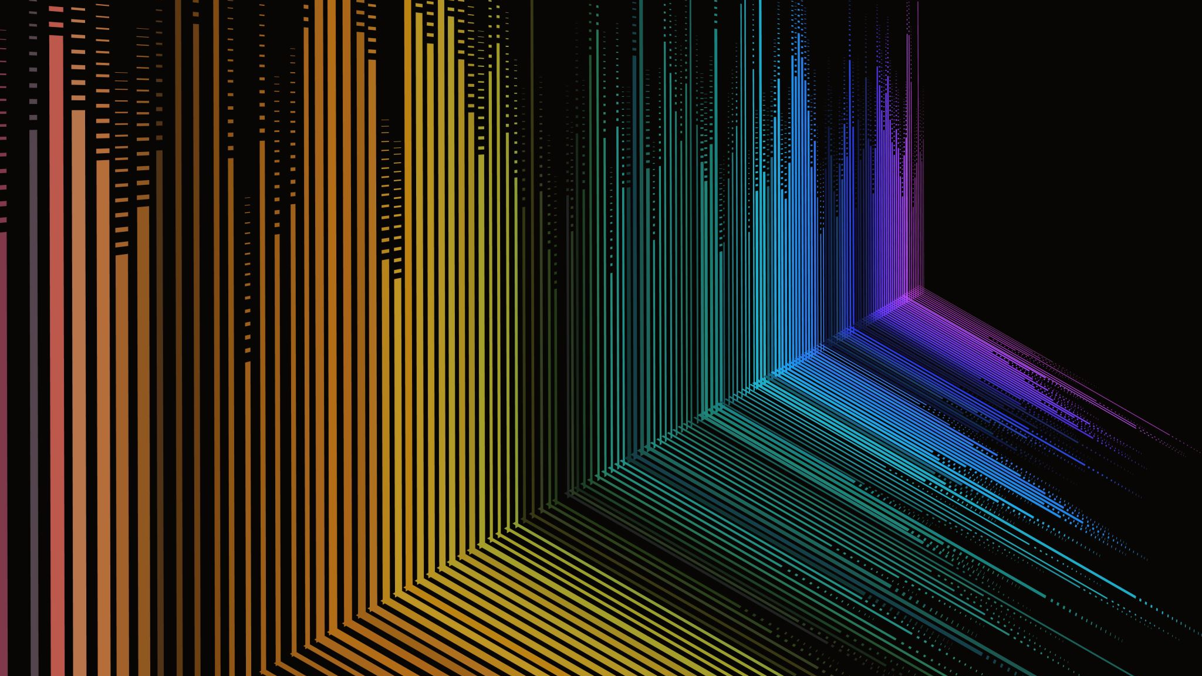
Train DQfD Model

Slide 119

Play Against DQfD

Slide 120

Play Against All Models via Web

Slide 121
Where Now?
We implore you to:
Expand your learning and application experience using RL, DQN, DQfD, and more
Explore other topics of RL and Machine Learning such as Natural Language Processing, Large Language Models, Generative Models, and more

Slide 122
Acknowledgements
Guest Speakers:
Haley Dozier
William Leonard
Joseph Jabour
Collaborators and Quality Assurance:
Joshua Church
Thomas Clement
Charles Carleton

Slide 123

Thank You!

Slide 124

End of Day 2

Slide 125

Citations

Slide 126
References
References
Jackson, Tyler, et al. Introduction to Reinforcement Learning Workshop. RL-WorkShop-Presentation.pptx, pp. 1-11.
Bellman, Richard. Dynamic Programming. Princeton University Press, 1957.
Sutton, Richard S., and Andrew G. Barto. Reinforcement Learning: An Introduction. 2nd ed., MIT Press, 2018.
Taylor, Matthew E., and Peter Stone. "Transfer Learning for Reinforcement Learning Domains: A Survey." Journal of Machine Learning Research, vol. 10, 2009, pp. 1633-1685.
Mnih, Volodymyr, et al. "Human-level Control Through Deep Reinforcement Learning." Nature, vol. 518, no. 7540, 2015, pp. 529-533.
Neumann, John von, and Oskar Morgenstern. Theory of Games and Economic Behavior. Princeton University Press, 1944.

Slide 127
References Continued…
Citations
For the introduction and general setup details of the workshop:
Jackson, Tyler, et al. Introduction to Reinforcement Learning Workshop. RL-WorkShop-Presentation.pptx, pp. 1-5.
For the historical context and key contributors to reinforcement learning:
Bellman, Richard. Dynamic Programming. Princeton University Press, 1957.
Sutton, Richard S., and Andrew G. Barto. Reinforcement Learning: An Introduction. 2nd ed., MIT Press, 2018.
For the explanation of Q-learning and its applications:
Jackson, Tyler, et al. Introduction to Reinforcement Learning Workshop. RL-WorkShop-Presentation.pptx, pp. 19-25.
For the discussion on reward shaping and its history:
Taylor, Matthew E., and Peter Stone. "Transfer Learning for Reinforcement Learning Domains: A Survey." Journal of Machine Learning Research, vol. 10, 2009, pp. 1633-1685.
For the minimax algorithm and its history:
Neumann, John von, and Oskar Morgenstern. Theory of Games and Economic Behavior. Princeton University Press, 1944.
For the drawbacks of traditional Q-learning and introduction to deep Q-learning:
Mnih, Volodymyr, et al. "Human-level Control Through Deep Reinforcement Learning." Nature, vol. 518, no. 7540, 2015, pp. 529-533.

